Slide 1





MENTAL HEALTH ASSESSMENT
Team : MADHESH R & rmmadhesh2711@gmail.com Guide: P.RAJA
Notes:
Slides: Prepare a short slide deck (10-12 slides) summarizing the project objectives, methodology, and key results.

Slide 2
OUTLINE
Abstract of the Project
Problem Statement
Proposed Solution
System Architecture
Live Demo of the Project
Embedded Video of Project
Conclusion
Future Scope

Slide 3
Abstract
Mental health disorders, such as depression and anxiety, are global concerns that impact millions of individuals, affecting their quality of life, relationships, and productivity. Early diagnosis and continuous monitoring of these conditions are crucial for effective intervention and management. Traditional mental health assessments, including patient self-reports and interviews, may not always provide an accurate or timely reflection of a person's emotional state. This project explores the use of facial expression recognition (FER) as a tool for detecting and monitoring emotional states associated with mood disorders, offering a novel approach to mental health assessment. By analyzing facial expressions using machine learning algorithms, the system can identify emotional cues such as sadness, anger, or fear, which are often linked to mental health conditions. The system architecture incorporates computer vision and deep learning techniques to accurately detect facial expressions in real-time, providing a non-invasive and objective means of monitoring patients' emotional states. The project aims to create a solution that can be integrated into clinical settings, offering healthcare providers valuable insights into patients' mental well-being. Furthermore, this tool can facilitate remote monitoring of patients, improving access to mental health care, especially in underserved regions.

Slide 4
Problem Statement
Mental health disorders such as depression, anxiety, and stress-related conditions are a growing concern worldwide, with increasing rates of incidence and a significant impact on society. Traditional methods for diagnosing and assessing these disorders often rely on subjective self-reporting, which can be influenced by various factors such as stigma, the patient's ability to articulate their emotions, or cognitive biases in the assessment process. Additionally, these methods may be time-consuming and expensive, making them inaccessible for large segments of the population, particularly in underserved or rural areas.
This project seeks to address these issues by creating a facial expression recognition system specifically designed to assess emotional states linked to mental health conditions. By automating the recognition of facial expressions, this system can provide a more objective, timely, and accessible means of monitoring a patient's emotional health.

Slide 5
Proposed Solution
The proposed solution leverages facial expression recognition technology, which uses machine learning algorithms and computer vision to detect and analyze facial movements. This system will be developed to assess a range of emotional states, such as happiness, sadness, anger, fear, surprise, and disgust. These emotions are strongly linked to various mental health conditions, such as depression, anxiety, and PTSD. By integrating this technology into clinical practices, it will provide healthcare professionals with a continuous, non-intrusive way to monitor the emotional states of their patients.
Facial Expression Recognition Algorithm: The heart of the system will be a machine learning-based facial expression recognition model trained on large datasets of facial images annotated with emotional labels.
Real-time Monitoring: Using cameras or smartphones, the system will capture real-time facial expressions and analyze them to detect emotional states.
Privacy and Ethical Considerations: Given the sensitive nature of emotional data, the system will include robust security measures to ensure patient privacy.

Slide 6
System Architecture
The architecture of the proposed facial expression recognition system can be divided into several layers, each performing specific tasks to ensure seamless operation.
Input Device: Cameras or smartphone sensors capture video frames or images of the patient's face. The device should have sufficient resolution to capture subtle facial expressions.
Using computer vision algorithms, such as Haar cascades or deep learning-based methods (like MTCNN or OpenCV), the system detects the face within the input image or video stream.
Feature Extraction: The system analyzes the facial landmarks (e.g., position of eyes, mouth, and eyebrows) using techniques like the Dlib library or OpenFace.

Slide 7
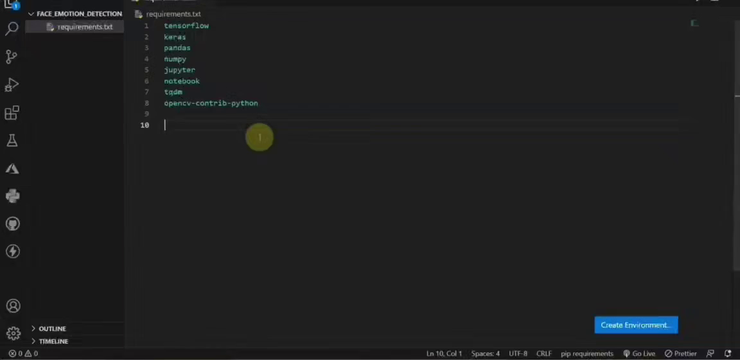
Video of Project Demo

Slide 8
Conclusion
This project proposes a novel approach to mental health assessment through the use of facial expression recognition technology. By leveraging the natural, non-intrusive way humans express emotions, this system can offer a continuous, real-time monitoring solution that supports early detection and ongoing management of mental health conditions such as depression and anxiety. The integration of this technology with existing healthcare systems could revolutionize how mental health professionals track and intervene with patients' emotional well-being.
By offering an accurate, real-time, and non-invasive way to assess emotions, the system enhances the capabilities of mental health practitioners and empowers patients to take an active role in managing their emotional health. Additionally, the ability to remotely monitor patients opens new possibilities for telehealth and care in underserved areas.

Slide 9
Future Scope
The facial expression recognition system proposed in this project holds great promise, but there are numerous avenues for future development and expansion. Here are some potential directions:
Multimodal Monitoring: In addition to facial expression recognition, integrating other sensors, such as voice analysis (tone, pitch, and speech patterns) or physiological sensors (heart rate, skin conductivity)
Cross-Cultural Adaptation: Facial expressions can vary significantly across different cultures.
Personalization: Developing algorithms that can adapt to an individual's unique facial features and emotional expression patterns will improve the system’s accuracy, particularly in recognizing subtle emotional changes.
Integration with Virtual Reality (VR) and Augmented Reality (AR): Integrating this system with VR or AR technologies could provide an immersive platform for mental health interventions

Slide 10
Thank you!
Notes:
thank you very much for joining this PPT, keep learning.

